Slide 1

Unit – 2 Introduction to DBMS
Database Management System (DBMS-I)
DU # 2301CS302
Prof. Dixita B. Kagathara
Computer Engineering Department
dixita.kagathara@darshan.ac.in
+91 - 97277 47317 (CE Department)

Slide 2
Topics to be covered
Overview of Database
Applications of Database
Purpose of the Database System
Advantages and Disadvantages of DBMS
Database Users and Administrators
Roles of DBA
Database System Architecture: Levels, Data Abstraction and Mapping
Types of Databases

Looping

Slide 3
Overview of DBMS

Slide 4
What is Database Management System (DBMS)?
What is Data?
What is Database?
What is Management?
What is System?

Slide 5
What is Database Management System (DBMS)?
Data - Fact that can be recorded or stored
e.g. Person Name, Gender and Weight etc.
Database - Collection of logically related data
e.g. Books Database in Library, Student Database in University, Customer Database in Bank etc.
Management - Manipulation, Searching and Security of data
e.g. Viewing result in UMS portal, Viewing attendance report in UMS portal etc.
System - Programs or tools used to manage database(s)
e.g. SQL Server Management Studio
DBMS
A Database Management System is a software for creating and managing databases.
Database Management System (DBMS) is a software designed to define, manipulate, retrieve and manage data in a database.
e.g. MS SQL Server, Oracle, My SQL, SQLite etc.

Slide 6
Basic Terms

Slide 7
Basic terms
Data
Data is raw, unprocessed facts that need to be processed.
Example: Marks of students
Student_1 = 50/100, Student_2 = 25/100.
Information
When data is processed, organized, structured or presented in a given context so as to make it useful, it is called information.
Example: Result of students (Pass or Fail)
Student_1 = Pass, Student_2 = Fail.

Slide 8
Difference between Data v/s Information
DATA | INFORMATION
Means knows facts, that can be recorded and have implicit meaning. | Means processed or organized data.
Examples: Student No: 12 Student Name: ABC City name : Rajkot Account No: 123456789 Balance : 10000 | Examples: Percentage : 81.31% (Derived from the marks of all subjects) Run rate in cricket match : 5.3 run/over (Derived from total runs and overs)
Row materials used to derive information. | Product derived from Data.
Less useful. | More useful.

Slide 9
Basic terms
Metadata
Metadata is data about data.
Data such as table name, column name, data type, constraints, authorized user and user access privileges for any table is called metadata for that table.
It is a complete description about database.
Metadata of above table is:
Table name such as Faculty
Column name such as Emp_Name, Address, Mobile_No, Subject
Datatype such as Varchar, Decimal
Access privileges such as Read, Write (Update)
Constraints such as Not NULL
Faculty
Emp_Name | Address | Mobile_No | Subject
Prof. Ajay Shah | Rajkot | 9876543210 | PPS

Slide 10
Basic terms
Data Dictionary
A data dictionary is an information repository which contains metadata.
Data Warehouse
A data warehouse is an information repository which stores data.
Table Name – Faculty
Column Name – EmpName, Address, Mob, Subject, Salary
Datatype – Varchar, Decimal
Access Privileges – Read, Write (Update)
This Information stores in Data Dictionary
Faculty
Emp_Name | Address | Mobile_No | Subject
Prof. Ajay Shah | Rajkot | 9876543210 | PPS
Prof. Ajay Patel | Surat | 0123456789 | DBMS

Slide 11
Basic terms
Field
A field is a character or group of characters that have a specific meaning.
E.g, the value of Emp_Name, Address, Mobile_No etc are all fields of Faculty table.
Record / Tuple
A record is a collection of logically related fields.
E.g, the collection of fields (Emp_Name, Address, Mobile_No, Subject) forms a record for the Faculty.
Faculty
Emp_Name | Address | Mobile_No | Subject
Prof. Ajay Shah | Rajkot | 9876543210 | PPS
Prof. Ajay Patel | Surat | 0123456789 | DBMS
Fields
Emp_Name
Address
Mobile_No
Prof. Ajay Shah | Rajkot | 9876543210 | PPS
Record / Tuple
Prof. Ajay Patel | Surat | 0123456789 | DBMS

Slide 12
Application of DBMS

Slide 13
Applications of DBMS
E-Commerce (Flikart, Amazon, Shopclues, eBay etc...)
Online Television Streaming (Hotstar, Amazon Prime etc...)
Social Media (WhatsApp, Facebook, Twitter, LinkedIn etc...)
Banking & Insurance
Airline & Railway
Universities and Colleges/Schools
Library Management System
Human Resource Department
Hospitals and Medical Stores
Government Organizations
Exercise
Write down any five applications of DBMS other than above.

Slide 14
Purpose of the Database System
Advantages of DBMS

Slide 15





3 ways to working with Data
Paper Oriented System
File Oriented System
Database Management System

Slide 16

Reduce data redundancy (duplication)
Computer
Civil
Emp_Name | Address | Mobile | Subject
Emp_Name | Address | Mobile | Subject
Prof. Ajay Shah | Rajkot | 1234 | PPS
Prof. Ajay Shah | Rajkot | 1234 | PPS
Database management system can remove such data redundancy by storing data centrally.
Same data is stored at
four different places.
Emp_Name | Address | Mobile | Subject
Emp_Name | Address | Mobile | Subject
Prof. Ajay Shah | Rajkot | 1234 | PPS
Prof. Ajay Shah | Rajkot | 1234 | PPS
Electrical
Mechanical

Slide 17
Remove data inconsistency
Computer
Civil
Emp_Name | Address | Mobile | Subject
Emp_Name | Address | Mobile | Subject
6789
Prof. Ajay Shah | Rajkot | 1234 | PPS
Prof. Ajay Shah | Rajkot | 1234 | PPS
Database management system can keep data in consistent state.
Same data having
different state (values)
Mobile no is changed
Emp_Name | Address | Mobile | Subject
Emp_Name | Address | Mobile | Subject
6789
Prof. Ajay Shah | Rajkot | 1234 | PPS
Prof. Ajay Shah | Rajkot | 1234 | PPS
Electrical
Mechanical

Slide 18
Data isolation
Data are scattered in various files.
Files may be in different formats.
Difficult to retrieve the appropriate data.
File - 1
Emp_Name | Address | Mobile | Subject
Prof. Ajay Shah | Rajkot | 1234 | PPS
DBMS allow us to access (retrieve) appropriate data easily.
File - 2
Emp_Name | Post | Salary | Load
Prof. Ajay Shah | Lecturer | 50,000 | 15
Database management system easily gives you data as per our requirement.
File - 3
Sr. No. | Name | Account No. | Bank
125 | Prof. Ajay Shah | 00012345678 | SBI

Slide 19


Guaranteed atomicity
Atomicity: Either transaction execute 0% or 100%.
Sum of both account before transfer is 3000
Person A
Account A
Bal : 2000
Transfer 500
Person B
Account B
Bal : 1000
Step 1 : Debit 500 from Account A
Step 2 : Credit 500 into Account B
Transaction is failed
Sum of both account is 2500
so inconsistent
Sum of both account
after transfer is 3000

Slide 20
Allow to implement integrity constraints
Emp_Name | Address | Mobile_No | Subject
Prof. Ajay Shah | Rajkot | 9876543210 | PPS
Should contain exact 10 digits
Student_Name | Branch | Backlog | SPI
Nirav Patel | Rajkot | 0 | 8.5
Should be between 0 to 10
DBMS allows us to implement such business rules in our database..

Slide 21

Sharing of data among multiple users
Want to access
Computer
Civil
Emp_Name | Address | Mobile | Subject
Emp_Name | Address | Mobile | Subject
Prof. Ajay Shah | Rajkot | 1234 | PPS
Prof. Ajay Shah | Rajkot | 1234 | PPS
Want to access
Database management system allows more than one user to access same data simultaneously.
Emp_Name | Address | Mobile | Subject
Emp_Name | Address | Mobile | Subject
Prof. Ajay Shah | Rajkot | 1234 | PPS
Prof. Ajay Shah | Rajkot | 1234 | PPS
Electrical
Mechanical

Slide 22

Restricting unauthorized access to data
File - 1
Emp_Name | Address | Mobile | Subject
Prof. Ajay Shah | Rajkot | 1234 | PPS
Wants to access
Faculty of other college
File - 2
Emp_Name | Post | Salary | Load
Prof. Ajay Shah | Lecturer | 50,000 | 15
Wants to access
Darshan Faculty
File - 3
Sr. No. | Name | Account No. | Bank
125 | Prof. Ajay Shah | 00012345678 | SBI
DBMS prevents unauthorized user to access data.

Slide 23
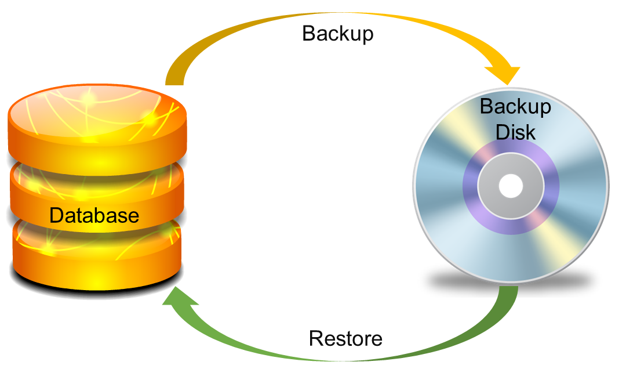
Providing backup and recovery services
Provides facilities to backup and restore the database in case of failure.

Slide 24
Advantages of DBMS (Summary)
Reduce data redundancy (duplication)
Avoids unnecessary duplication of data by storing data centrally.
Remove data inconsistency
By eliminating redundancy, data inconsistency can be removed.
Data isolation
A user can easily retrieve proper data as per his/her requirement.
Guaranteed atomicity
Either transaction executes 0% or 100%.
Allow implementing integrity constraints
Business rules can be implemented such as do not allow to store amount less than Rs. 0 in balance.
Sharing of data among multiple users
More than one users can access same data at the same time.
Restricting unauthorized access to data
A user can only access data which is authorized to them.
Providing backup and recovery services
Can take a regular auto or manual backup and use it to restore the database if it corrupts.

Slide 25
Disadvantages of DBMS
Complexity
DBMS can be complex to set up and maintain, requiring specialized knowledge and skills.
Cost
The cost of purchasing, maintaining and upgrading a DBMS can be high, especially for large or complex systems.
Not beneficial for small firms
Traditional file systems work better for small-scale firms as compared to DBMS.
it’s quite expensive for them to use DBMS.

Slide 26
Types of Database User

Slide 27


Types of Database Users
Naive Users (End Users)
Unsophisticated users who have zero knowledge of database system.
End user interacts to database via sophisticated software or tools.
e.g. Clerk in bank
Application Programmers
Programmers who write software using tools such as Java, .Net, PHP etc…
Writes application programs to interact with the database.
e.g. Software developers

Slide 28

Types of Database Users
Sophisticated Users
Interact with database system without using an application program
They form their request by using database query language or by using tool such as data analysis software.
e.g. Data Analyst
Specialized Users (DBA)
Has central control over the database
Responsible for proper functioning DB
Authorizing access to the Database
e.g. Database Administrator

Slide 29
Roles of DBA

Slide 30
Role of DBA
Schema Definition/DB Design
DBA defines the logical schema of the database.
Storage Structure and Access Method Definition
DBA decides how the data is to be represented in the database & how to access it.
Defining Security and Integrity Constraints
DBA decides on various security and integrity constraints.
Granting of Authorization for Data Access
DBA determines which user needs access to which part of the database.
Liaison with Users
DBA provide necessary data to the user.
Assisting Application Programmer
DBA provides assistance to application programmers to develop application programs.
Monitoring Performance
DBA ensures that better performance is maintained by making a change in the physical or logical schema if required.
Backup and Recovery
DBA backing up the database on some storage devices such as DVD, CD or magnetic tape or remote servers and recover the system in case of failures.

Slide 31
Three Level ANSI SPARC Database System

Slide 32

3 Levels ANSI SPARC Database System
User 1
User 2
User 3
How data are viewed by each users?
View 1
View 2
View 3
View
Level
What data are stored and
What relationships exist?
Conceptual
Level
Logical
Level
How the data are actually stored on storage devices?
Internal
Level
Physical
Level
ANSI = American National Standard Institute
SPARC = Standard Planning And Requirement Committee
Database

Slide 33
3 Levels ANSI SPARC Database System
Internal level (Physical level)
It describes how a data is stored on the storage device.
Deals with physical storage of data.
Structure of records on disk - files, pages, blocks and indexes and ordering of records
Internal view is described by the internal schema.
Conceptual level (Logical level)
What data are stored and what relationships exist among those data?
It hides low level complexities of physical storage.
For Example, STUDENT database may contain STUDENT and COURSE tables which will be visible to users but users are unaware about their storage.
Database administrator works at this level to determine what data to keep in the database.
External level (View level)
It describes only part of the entire database that an end user concern or how data are viewed by each user.
Different user needs different views of the database, so there can be many views in a view level abstraction of the database. Used by end users and application programmers.
End users need to access only part of the database rather than the entire database.

Slide 34
3 Levels ANSI SPARC Database System: Example
We are storing student information in a student table.
User 1
User 2
User 3
User just interact with system with the help of GUI.
Users are not aware of how and what the data is stored.
View 1
View 2
View 3
View
Level
Records can be described as fields and attributes along with their data types, their relationship among each other can be logically implemented.
DBA and Designer generally work at this level.
Conceptual
Level
Logical
Level
Records can be described as blocks of storage (bytes, gigabytes, terabytes etc.) in memory.
These details are often hidden from the programmers.
Internal
Level
Physical
Level
Database

Slide 35
Data Abstraction
Database systems are made-up of complex data structures.
To ease the user interaction with database, the developers hide internal irrelevant details from users.
This process of hiding irrelevant details from user is called data abstraction.

Slide 36
Mapping
Want to access some data
User 1
User 2
User 3
View 1
View 2
View 3
View
Level
Request
External/Conceptual Mapping
Conceptual
Level
Logical
Level
Conceptual/Internal Mapping
Internal
Level
Physical
Level
Process of transforming requests and results between the three levels is called mapping.
Result
Database

Slide 37
Data Independence
The ability to modify a schema definition in one level without affecting a schema definition in the next higher level.
Physical data independence
Physical data independence allows changing in physical storage devices or organization of file without change in the conceptual view.
Modifications at the internal level are occasionally necessary to improve performance.
It is easy to achieve physical data independence.
Logical data independence
Logical data independence is the ability to modify the conceptual schema without requiring any change in view level.
Modifications at the logical level are necessary whenever the logical structure of the database is altered.
Sometime it is difficult to achieve logical data independence.

Slide 38
Advantages of 3 Levels ANSI SPARC Database System

Slide 39
Advantages of 3 Levels ANSI SPARC Database System
Same data can be access by different users in different customized views.
ADMIN VIEW
SrNo | Name | Mobile | City | Branch
258 | Prof. Ankit Patel | 8325845127 | Jetpur | Electrical
125 | Prof. Akshay Jadeja | 7878450512 | Rajkot | Computer
312 | Prof. Manish Sharma | 9824485601 | Rajkot | Civil
457 | Prof. Bhavin Oza | 9825088621 | Jamnagar | Mechanical
STUDENT VIEW
FACULTY VIEW
Name | Mobile | Branch
Prof. Ankit Patel | 8325845127 | Electrical
Prof. Akshay Jadeja | 7878450512 | Computer
Prof. Manish Sharma | 9824485601 | Civil
Prof. Bhavin Oza | 9825088621 | Mechanical
SrNo | Name | Mobile | Branch
258 | Prof. Ankit Patel | 8325845127 | Electrical
125 | Prof. Akshay Jadeja | 7878450512 | Computer
312 | Prof. Manish Sharma | 9824485601 | Civil
457 | Prof. Bhavin Oza | 9825088621 | Mechanical

Slide 40
Advantages of 3 Levels ANSI SPARC Database System
The user is not conserved about the physical data storage details.
Table | Column | Data type | Length | Precision | Scale | Primary Key | Nullable | Default | Comment
FACULTY | SrNo | NUMBER | - | 3 | 0 | - | √ | - | -
 | Name | VARCHAR | 50 | - | - | - | √ | - | -
 | Mobile | NUMBER | - | 10 | 0 | - | √ | - | -
 | City | VARCHAR | 30 | - | - | - | √ | - | -
 | Branch | VARCHAR | 30 | - | - | - | √ | - | -

Slide 41
Advantages of 3 Levels ANSI SPARC Database System
Conceptual structure of the database can be changed without affecting end users.
Table | Column | Data type | Length | Precision | Scale | Primary Key | Nullable | Default | Comment
FACULTY | SrNo | NUMBER | - | 3 | 0 | - | √ | - | -
 | Name | VARCHAR | 50 | - | - | - | √ | - | -
 | Mobile | INT | 10 | - | - | - | √ | - | -
 | City | VARCHAR | 30 | - | - | - | √ | - | -
 | Branch | VARCHAR | 30 | - | - | - | √ | - | -
VARCHAR
SrNo | Name | Mobile | City | Branch
258 | Prof. Ankit Patel | 8325845127 | Jetpur | Electrical
125 | Prof. Akshay Jadeja | 7878450512 | Rajkot | Computer
312 | Prof. Manish Sharma | 9824485601 | Rajkot | Civil
457 | Prof. Bhavin Oza | 9825088621 | Jamnagar | Mechanical

Slide 42
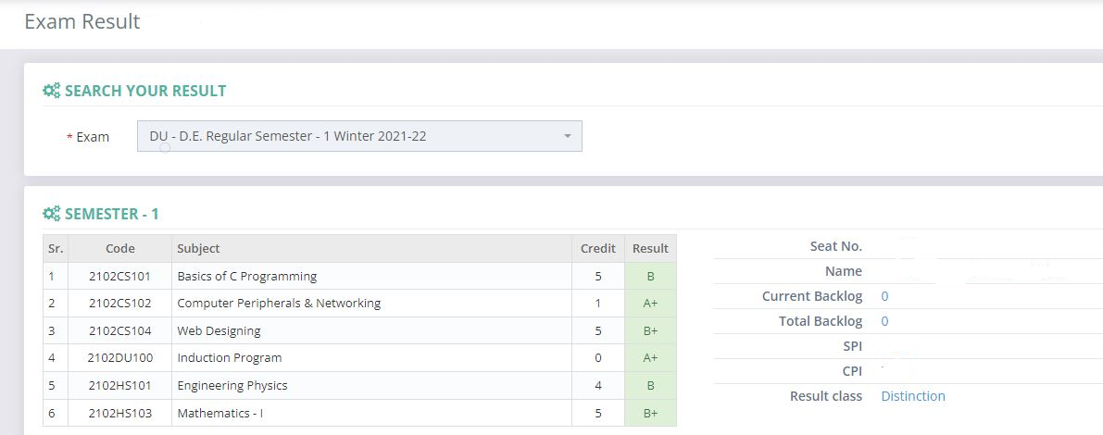

Advantages of 3 Levels ANSI SPARC Database System
Physical storage structure can be changed without requiring changes in user’s view.
DARSHAN SERVER

Slide 43
Database System Architecture

Slide 44
Database System Architecture
Naive User
Application Programmer
Sophisticated User
Database Administrator
uses
write
uses
uses
Application interface
Application Program
Query Tool
Administrator Tool
Interprets DDL statements into a set of tables containing metadata
Compiler and Linker
DML queries
DDL interpreter
Translates DML statements into low level instructions that the query evaluation engine understands
Executes low level instructions generated by DML compiler and choose best evolution plan
Application program object code
DML compiler and organizer
Query Evaluation Engine
Query Processor
Deal with execution of DDL and DML statements

Slide 45
Database System Architecture
Naive User
Application Programmer
Sophisticated User
Database Administrator
uses
write
uses
uses
Application interface
Application Program
Query Tool
Administrator Tool
Compiler and Linker
DML queries
DDL interpreter
Manages allocation of space on disk storage
Application program object code
DML compiler and organizer
Query Evaluation Engine
Query Processor
Preserves atomicity
Fetches data from disk storage to memory for being used
Buffer Manager
File Manager
Authorization and Integrity Manager
Transaction Manager
Provides interface between low-level data stored and application program and queries
Storage Manager
Checks the authority of users to access data and integrity constraints

Slide 46
Database System Architecture
Naive User
Application Programmer
Sophisticated User
Database Administrator
uses
write
uses
uses
Application interface
Application Program
Query Tool
Administrator Tool
Compiler and Linker
DML queries
DDL interpreter
Application program object code
DML compiler and organizer
Query Evaluation Engine
Query Processor
Buffer Manager
File Manager
Authorization and Integrity Manager
Transaction Manager
Storage Manager
To provide faster access to data items
To store metadata
Indices
Data Dictionary
Disk Storage
To store user data
Statistical Data
To store statistical information about the data
Data

Slide 47
Types of Databases

Slide 48
Types of Database
The types of DBMS based on data model are as follows:
Relational database
Object oriented database
Hierarchical database
Network database

Slide 49
Types of Database
Relational database
A relational database management system (RDBMS) is a system where data is organized in two-dimensional tables using rows and columns.
Object oriented database
It is a system where information or data is represented in the form of objects which is used in object-oriented programming.
Object Oriented Model
Class
Object
Variable
Method
Relational Model
Relation/Table
Tuple/Record
Attribute/Column
Stored procedure
Faculty
Emp_Name | Address | Mobile_No | Subject
Prof. Ajay Shah | Rajkot | 9876543210 | PPS
Prof. Ajay Patel | Surat | 0123456789 | DBMS

Slide 50
Types of Database
Hierarchical Databases
It is a system where the data elements have a one to many relationship (1: N).
Here data is organized like a tree which is similar to a folder structure in your computer system.
Network Databases
It is the database that typically follows the network data model.
Here, the representation of data is in the form of nodes connected via links between them.
Unlike the hierarchical database, it allows each record to have multiple children and parent nodes to form a generalized graph structure.
University
Departments
Students
University
Professors
Classes
Current
Former
Department
Library
Full time
Adjunct
Students

Slide 51
Thank You

